Slide 1
Image Classifier
using Keras
Submitted By:
Aayushi Bisht
& Harshit Saxena

Slide 2
Introduction
The objective of image classification is to identify and portray, as a unique gray level (or color), the features occurring in an image in terms of the object or type of land cover these features actually represent on the ground. Image classification is perhaps the most important part of digital image analysis.

Slide 3
Keras
Keras is an open-source neural network library written in Python. It is capable of running on top of Tensorflow, Microsoft Cognitive Toolkit, R, Theano, or PlaidML. Designed to enable fast experimentation with deep neural networks, it focuses on being user-friendly, modular, and extensible.

Slide 4
Project Overview
Abstract
In this project, we have built a convolution neural network in Keras with python on fashion MNIST dataset. We explored our dataset, and then trained our neural network using R and Keras library.

Slide 5
About Fashion MNIST Dataset
Fashion-MNIST is a dataset of Zalando's article images consisting of a training set of 60,000 examples and a test set of 10,000 examples. Each example is a 28x28 grayscale image, associated with a label from 10 classes. The classes are as follows:
T-shirt/top
Trouser/pants
Pullover shirt
Dress
Coat
Sandal
Shirt
Sneaker
Bag
Ankle boot

Slide 6
Methodology
The project following 8 steps:
Step 1: Import the Keras Library
Step 2: Import the Fashion MNIST Dataset
Step 3: Data Exploration
Step 4: Preprocess the Data
Step 5: Build the Model
Step 6: Compile the Model
Step 7: Train and Evaluate the Model
Step 8: Make Predictions on Test Data

Slide 7
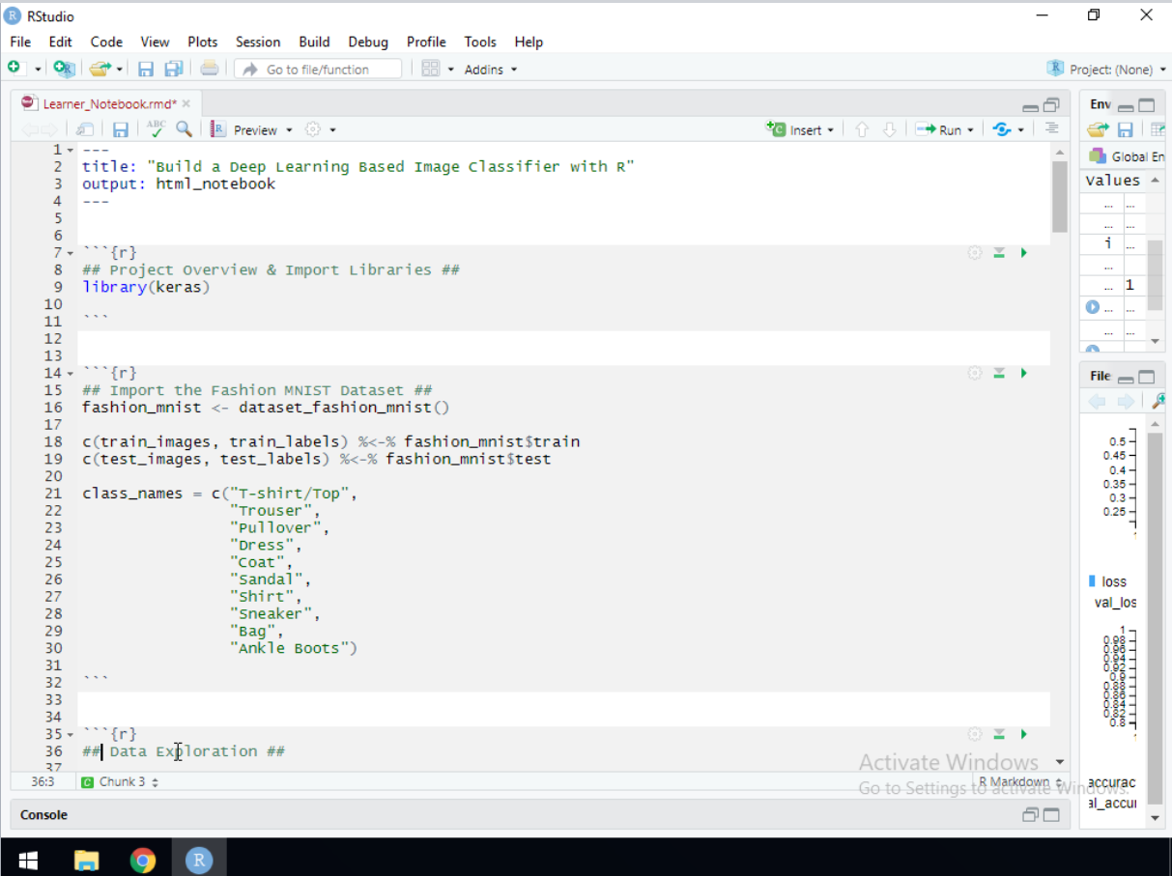
Step 1: Import the Keras Library

Slide 8
Step 2: Import the Fashion MNIST Dataset

Slide 9
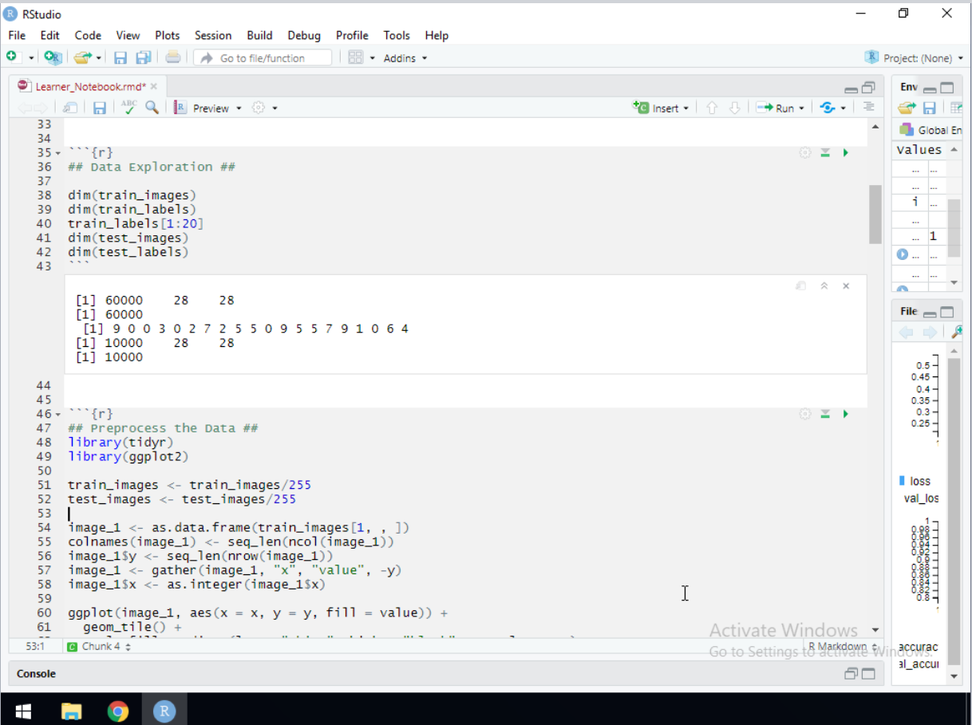
Step 3: Data Exploration

Slide 10
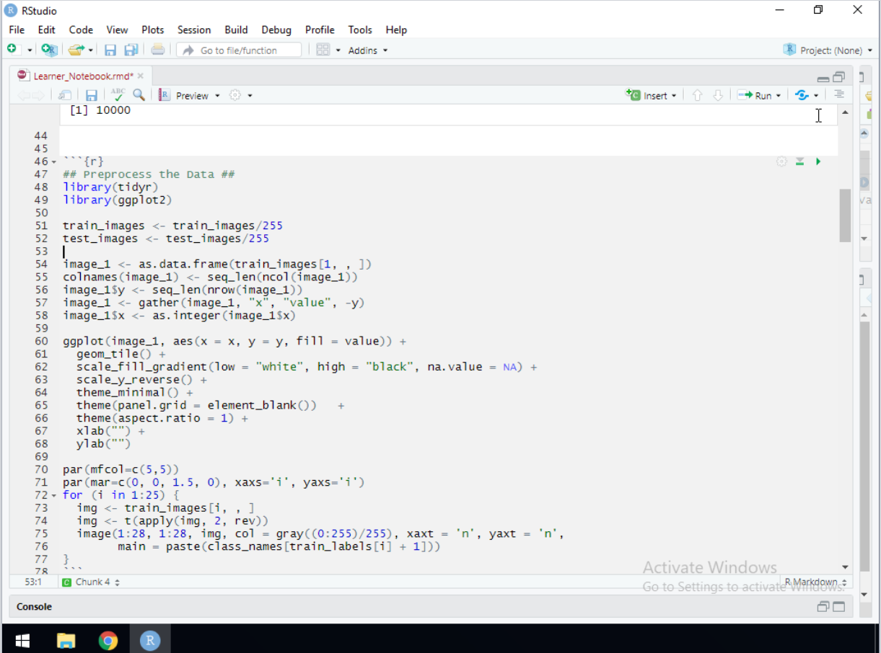
Step 4: Preprocess the Data

Slide 11
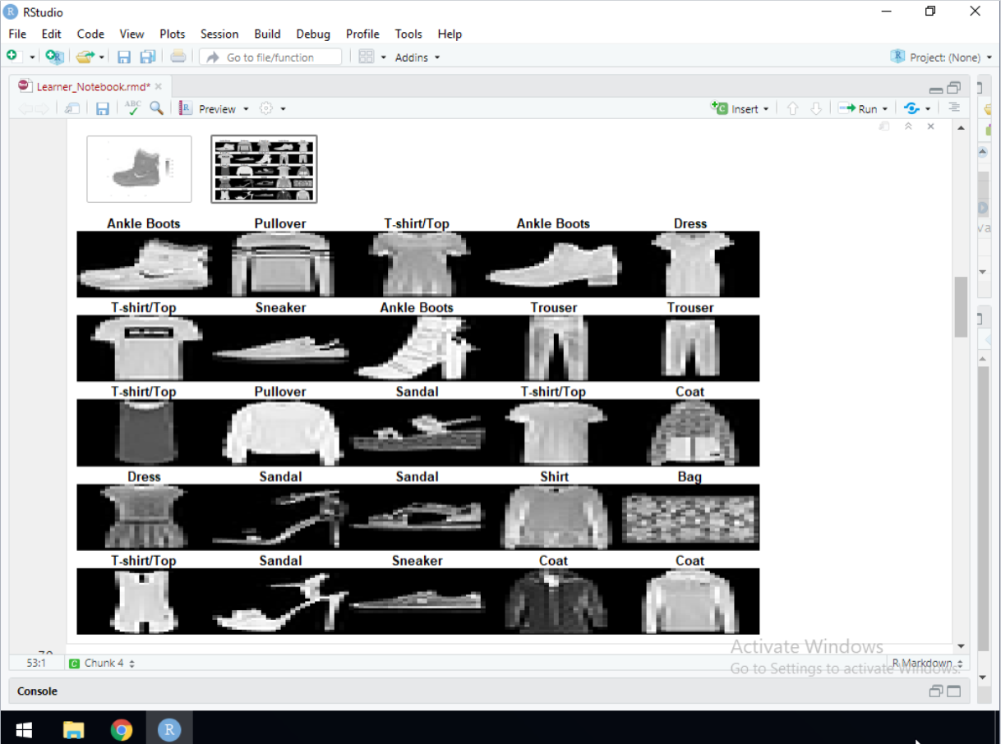

Slide 12
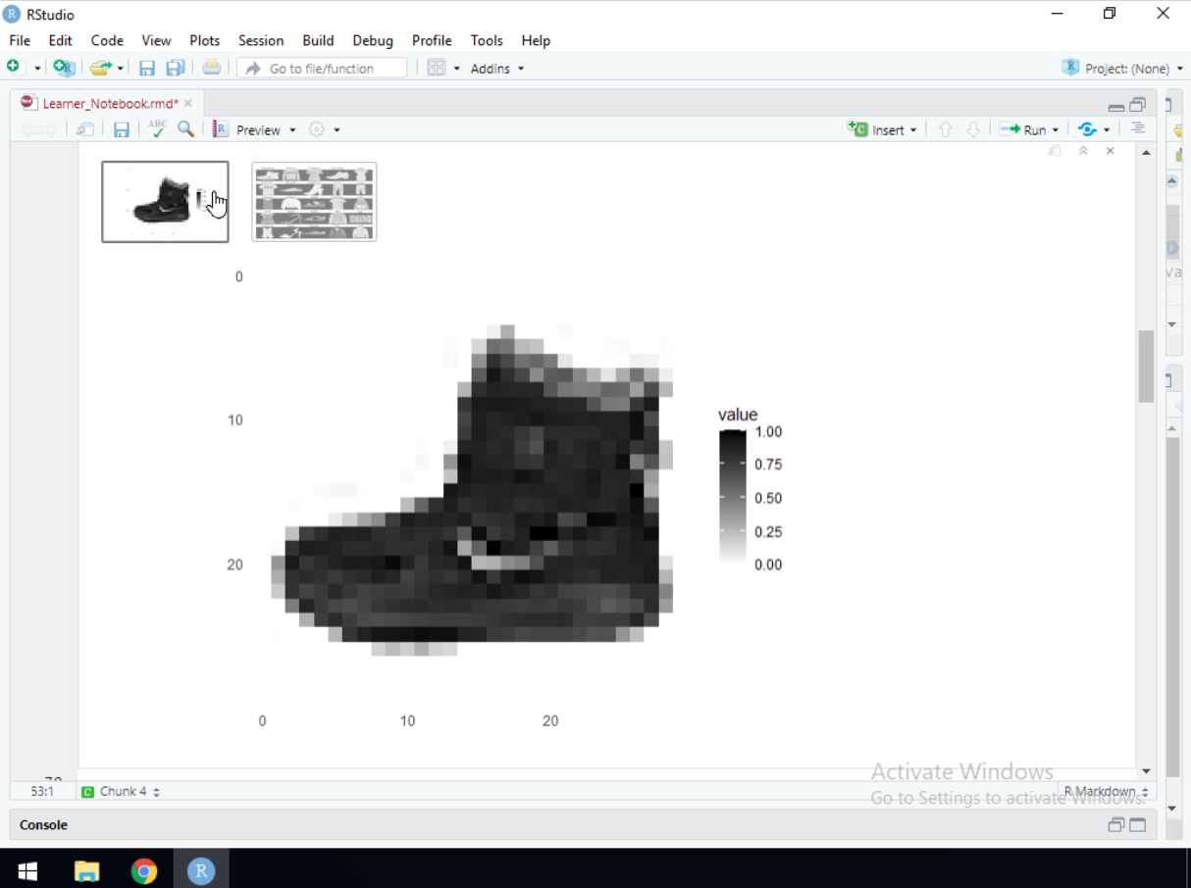

Slide 13
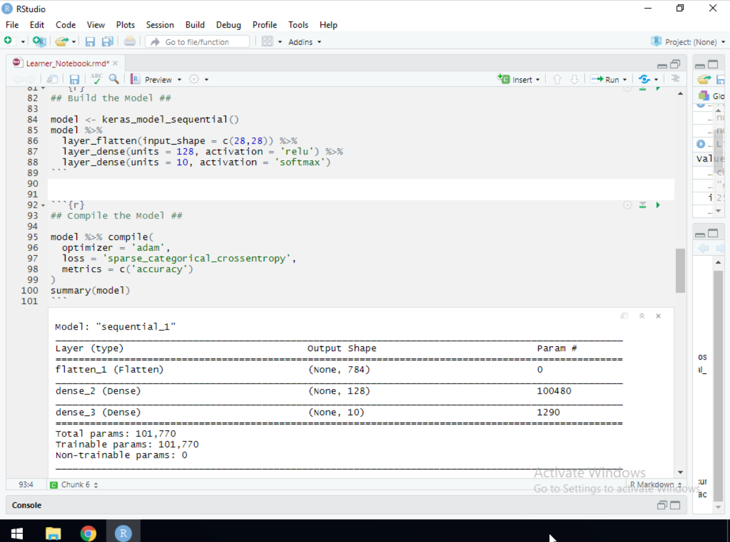
Step 5: Build the Model

Slide 14
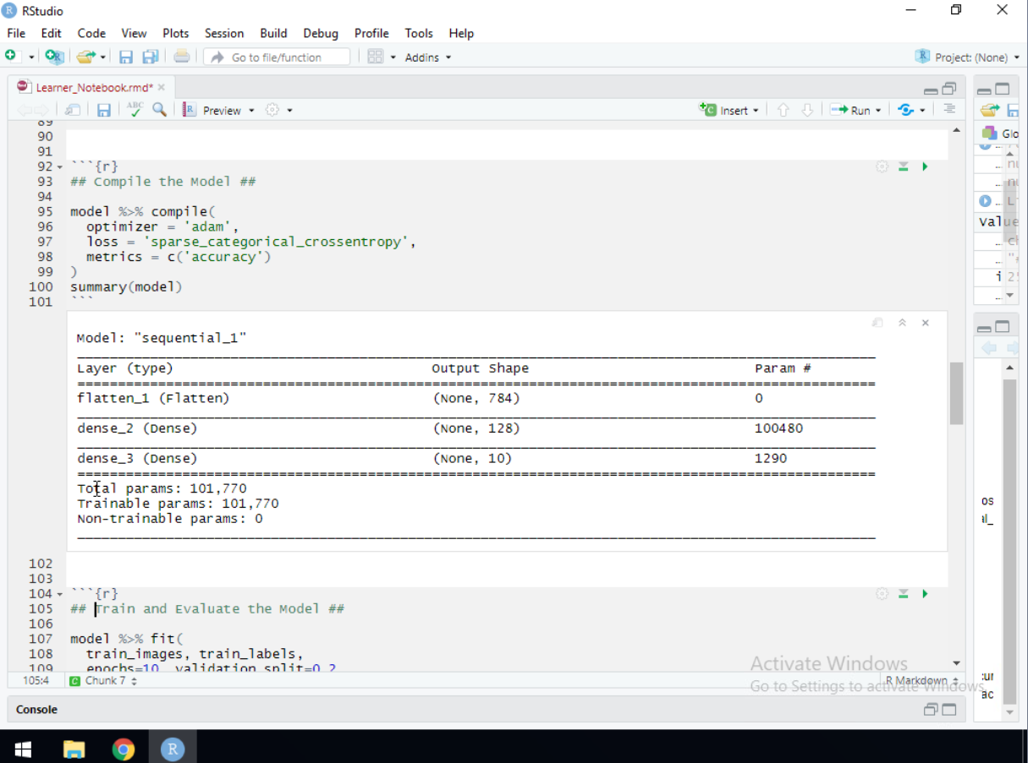
Step 6: Compile the Model

Slide 15
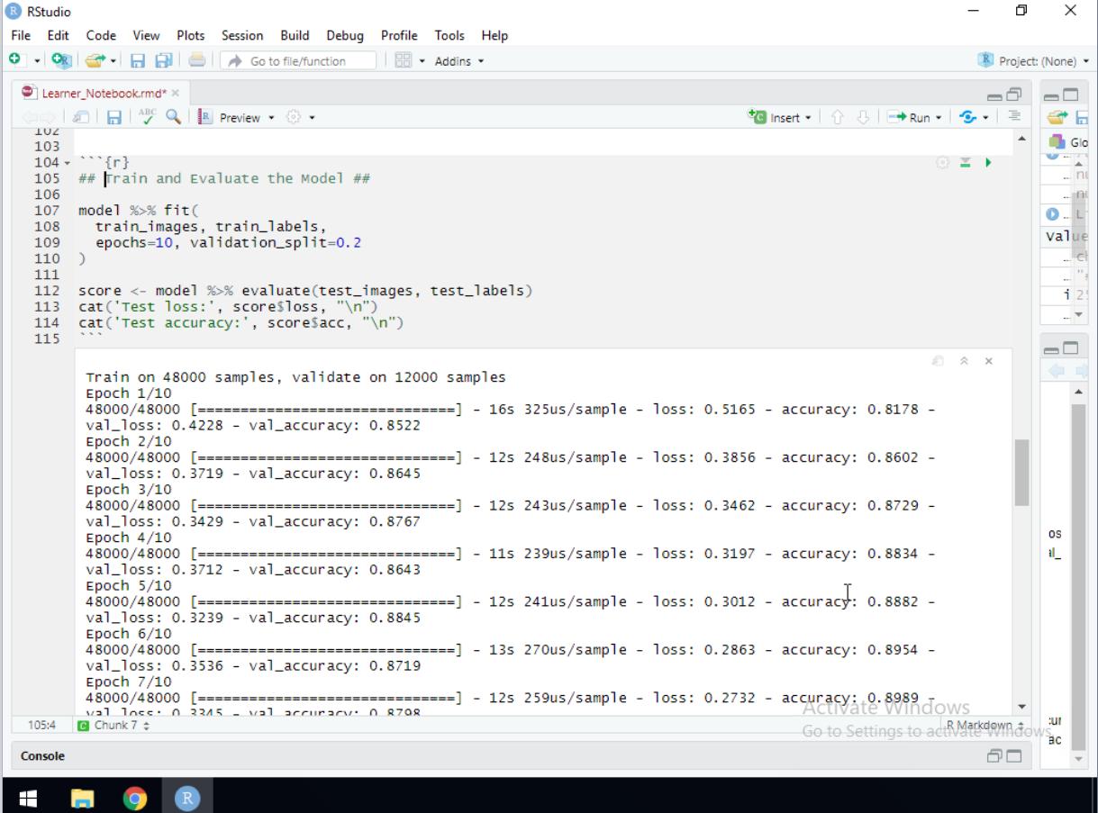
Step 7: Train and Evaluate the Model

Slide 16
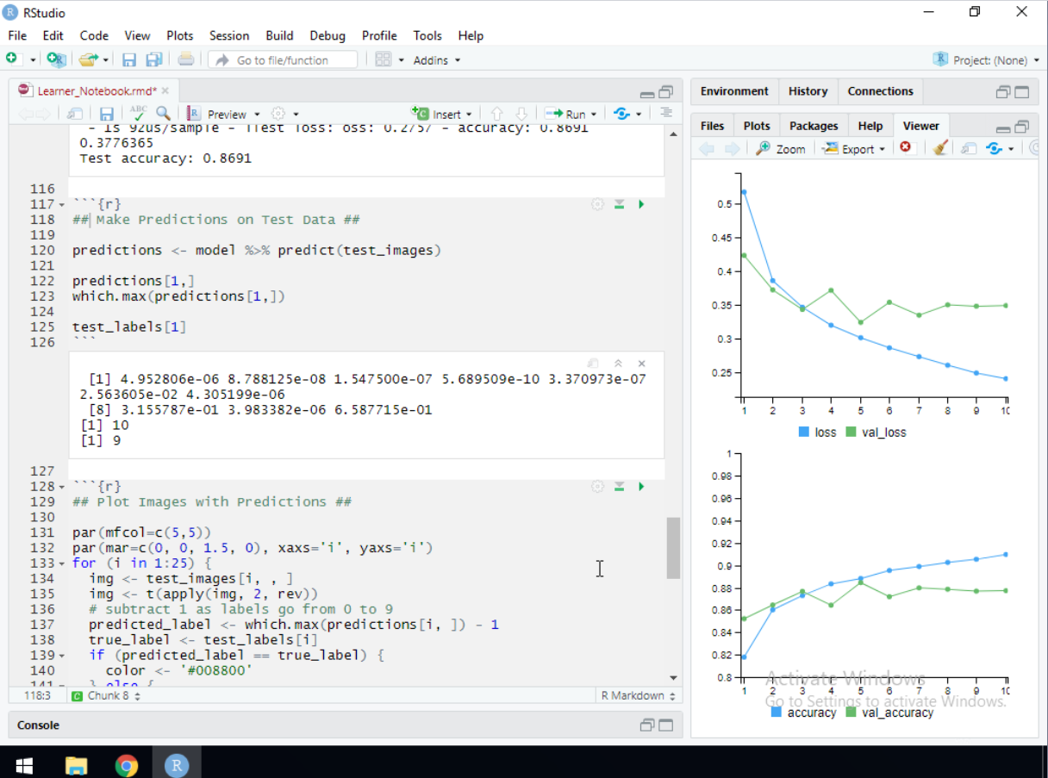
Step 8: Make Predictions on Test Data

Slide 17
